Slide 1
What's New in Visual Studio 2017
Kalin Bowden

Slide 2
“Every thing Microsoft touches turns into a running joke… except Visual Studios”

Slide 3
From Visual Studios 97 to Visual Studios 17

Slide 4
So what is new?
New Install Experience
Get Up and Running Faster
Write Code More Easily
Better Debugging
Live Unit Testing
Enterprise Only

Slide 5
New Install Experience
Faster Install
Customize Your Install
Better Uninstall Experience

Slide 6
Faster Install
Small and fast core editor
Only a few MB in size
Syntax awareness
Source code control
Intellisense
Key word colorization
Support for 20+ languages
C#, Ruby, Peral, Go, PowerShell, etc.
Work with any folder without making a project
Minimum install is 10X smaller than VS15

Slide 7
Lower System Impact
VS17 has less dependences system wide
More Isolated
Cleaner Uninstall
Side by side installs without conflicts
Installation nicknames

Slide 8
Get Up and Running Faster
New start page
Light weight solution load
Improved solution load

Slide 9
New Start Page
Developer News
New Project
Open
Checkout from all source control sources
Recent and Pinned
Roaming projects

Slide 10
Faster Solution Load
https://youtu.be/QikIbuSAUE8?t=304

Slide 11
Write Better Code Faster
Dots!!!
Toggle full solution analysis
New Intellisense
CamelCase matching
Filters
Dot to Dot
New GoToAll
New find all references
Package install on the fly
Code enforcement/suggestions
Project specific enforcement

Slide 12
Better Debugging
Run to click
New exception helper

Slide 13
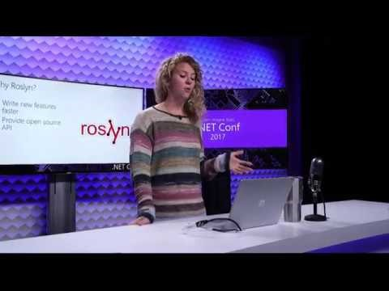
Live Unit Testing

Slide 14
So What's Next?
Dead Code
Bulk fix for code stylings

Slide 15
Highlights
New fast customizable installer
New start page
New small core editor
Code suggestions
Live unit testing

